Slide 1
RNA-seq to study HIV Infection in cells
Rebecca Batorsky
Sr Bioinformatics Specialist
Oct 2020

Slide 2

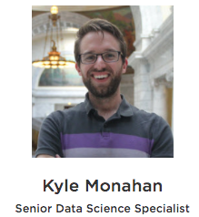
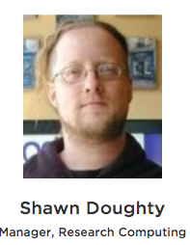
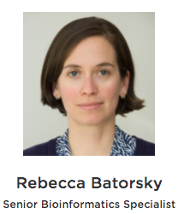

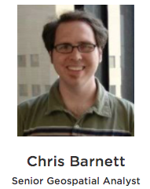
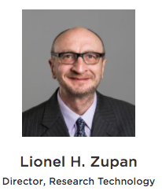
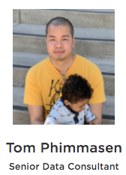


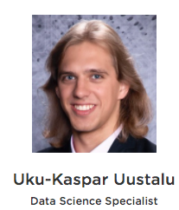

Research Technology Team
Meg Farley
Bioinformatics Intern
Consultation on Projects and Grants
High Performance Compute Cluster
Workshops
https://it.tufts.edu/research-technology

Slide 3
Overview
10/27
RNA sequencing
Bulk RNA sequencing
Single cell RNA sequencing
Intro to Galaxy platform for bioinformatics
11/3
Work through RNAseq example together on Galaxy

Slide 4
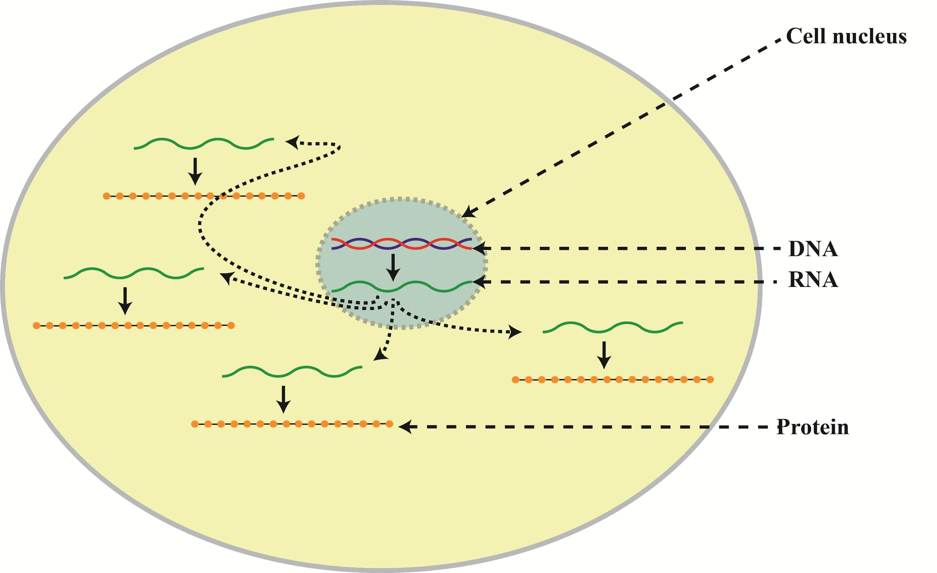
DNA and RNA in a cell
https://i0.wp.com/science-explained.com/wp-content/uploads/2013/08/Cell.jpg
Notes:
The role of DNA and RNA in a cell, and typical analysis goals

Slide 5
Two common analyses
DNA Sequencing
RNA Sequencing
Fixed copy of a gene per cell
Analysis goal:
Variant calling and interpretation
Copy of a gene (mRNA) per cell depends on gene expression
Analysis goal:
Bulk : Differential expression
Single cell : Quantify different cell populations
https://i0.wp.com/science-explained.com/wp-content/uploads/2013/08/Cell.jpg

Slide 6
Today we will cover RNA sequencing
DNA Sequencing
RNA Sequencing
Fixed copy of a gene per cell
Analysis goal:
Variant calling and interpretation
Copy of a gene (mRNA) per cell depends on gene expression
Analysis goal:
Bulk : Differential expression
Single cell : Quantify different cell populations
https://i0.wp.com/science-explained.com/wp-content/uploads/2013/08/Cell.jpg

Slide 7
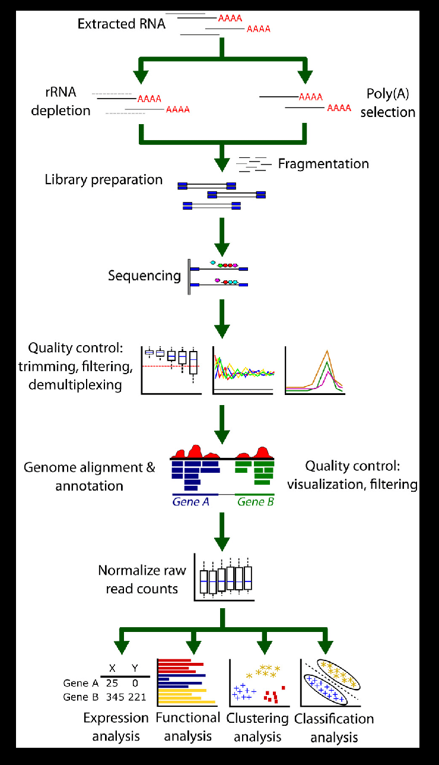
“Bulk” RNA seq workflow
Library prep and sequencing
Bioinformatics
Good resource: Griffiths et al Plos Comp Bio 2015

Slide 8
RNA seq library prep and sequencing
Good resource: Griffiths et al Plos Comp Bio 2015
Notes:
Isolation of total RNA, enrichment for messenger RNA which is the template that will be translated into proteins.
In humans, ~95%–98% of all RNA molecules may be rRNAs.
After that, the RNA is fragmented into smaller pieces that will be the desired size for the sequencing process.
cDNA Adapter are ligated

Slide 9
RNA seq library prep and sequencing
Enrichment for mRNA
In humans, ~95%–98% of all RNA molecules are rRNAs
Good resource: Griffiths et al Plos Comp Bio 2015
Notes:
Isolation of total RNA, enrichment for messenger RNA which is the template that will be translated into proteins.
In humans, ~95%–98% of all RNA molecules may be rRNAs.
After that, the RNA is fragmented into smaller pieces that will be the desired size for the sequencing process.
cDNA Adapter are ligated

Slide 10
RNA seq library prep and sequencing
Enrichment for mRNA
In humans, ~95%–98% of all RNA molecules are rRNAs
Random priming and reverse transcription
Double stranded cDNA synthesis
Sequencing adapter ligation
Good resource: Griffiths et al Plos Comp Bio 2015
Notes:
Isolation of total RNA, enrichment for messenger RNA which is the template that will be translated into proteins.
In humans, ~95%–98% of all RNA molecules may be rRNAs.
After that, the RNA is fragmented into smaller pieces that will be the desired size for the sequencing process.
cDNA Adapter are ligated

Slide 11
RNA seq bioinformatics
Good resource: Griffiths et al Plos Comp Bio 2015

Slide 12
Goal of RNAseq
“How can we detect genes for which the counts of reads change between conditions more systematically than as expected by chance”
Oshlack et al. 2010. From RNA-seq reads to differential expression results. Genome Biology 2010, 11:220 http://genomebiology.com/2010/11/12/220

Slide 13
Our dataset for next week
Next-Generation Sequencing Reveals HIV-1-Mediated Suppression of T Cell Activation and RNA Processing and Regulation of Noncoding RNA Expression in a CD4⁺ T Cell Line
Stewart T. Chang, Pavel Sova, Xinxia Peng, Jeffrey Weiss, G. Lynn Law, Robert E. Palermo, Michael G. Katze
Mock Infected CD4+ T Cells
HIV Infected CD4+ T Cells
12 hour
24 hour
https://www.ncbi.nlm.nih.gov/pubmed/21933919

Slide 14
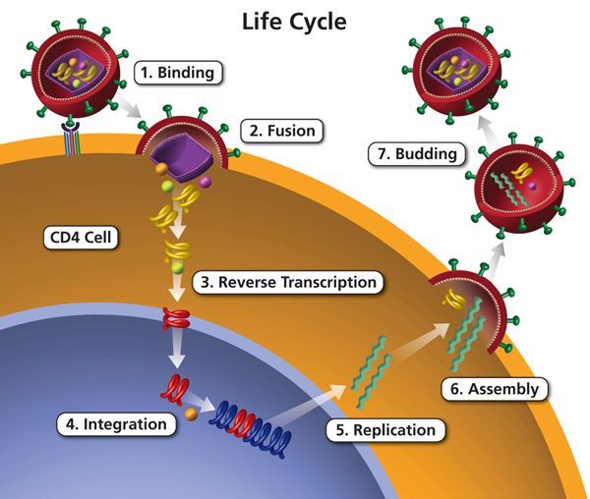
HIV lifecycle
https://aidsinfo.nih.gov/understanding-hiv-aids/glossary/1596/life-cycle
Notes:
HIV is a retrovirus (enveloped RNA virus) that infects immune cells.
Viral proteins on the envelope bind with host cell entry receptors.
The viral genetic material enters the cell, is reverse transcribed, and eventually integrated into the host DNA.
At this point the virus can either lay dormant, or start replicating.
During transcription, the integrated DNA provirus is transcribed to RNA some of which are translated into proteins which enable new viral particles to be assembled and bud from the host cell.

Slide 15
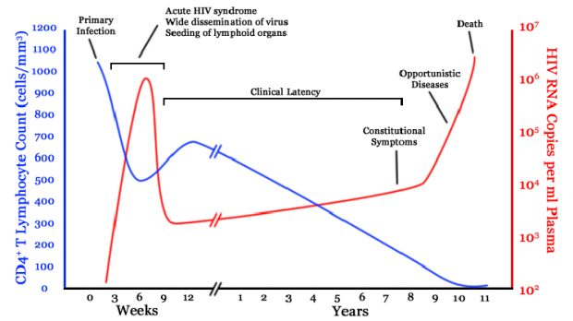
HIV lifecycle
HIV infection in a human host
https://aidsinfo.nih.gov/understanding-hiv-aids/glossary/1596/life-cycle
Notes:
The course of infection in a human host has some interesting properties, here plotted over the first 10 years of infection.
On the left y axis, the CD4T cell count and on the right y axis in red, the viral load.
Initial acute infection followed by a long latent period of low viral load, slowely declining T cells count.
Finally, due to factors not totally understood, viral load climbs and T cell count declines and AIDS sets in.
Part of what makes the dynamics so interesting here is that, since the virus infects immune cells, there is a balance:
The more CD4T cells, the more food for the virus,
The more CD4T cells, the more host defenses to attack and kill infected cells.

Slide 16
The study question
What changes take place in the first 12-24 hours of HIV infection in terms of gene expression of host cell and viral replication levels?
https://aidsinfo.nih.gov/understanding-hiv-aids/glossary/1596/life-cycle
Notes:
Part of the inter

Slide 17
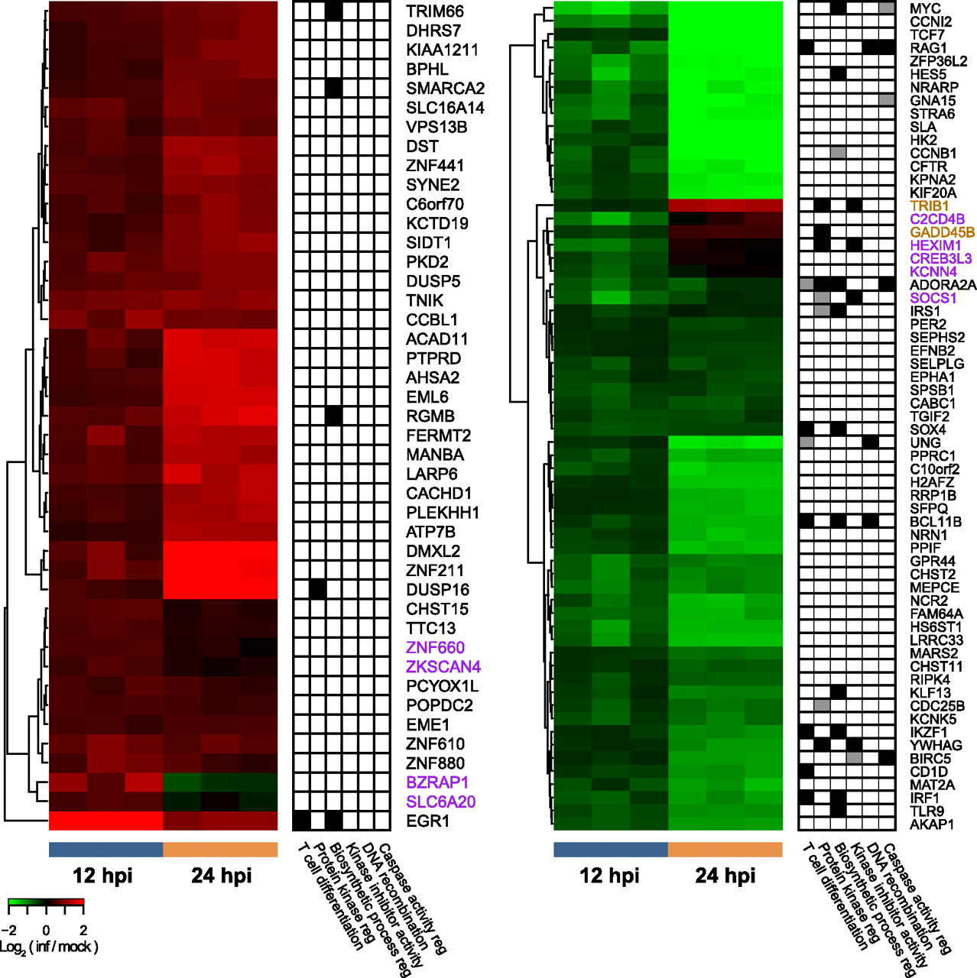
Study findings
20% of reads mapped to HIV at 12 hr, 40% at 24 hr
Downregulation of T cell activation genes at 12 hr
‘Large-scale disruptions to host transcription’ at 24 hr

Slide 18
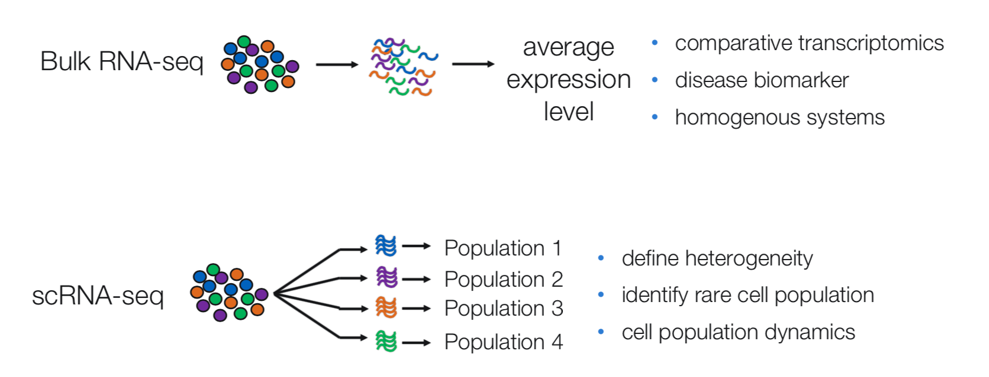
Bulk vs Single Cell RNA Sequencing
https://github.com/hbctraining/scRNA-seq
Notes:
The role of DNA and RNA in a cell, and typical analysis goals

Slide 19
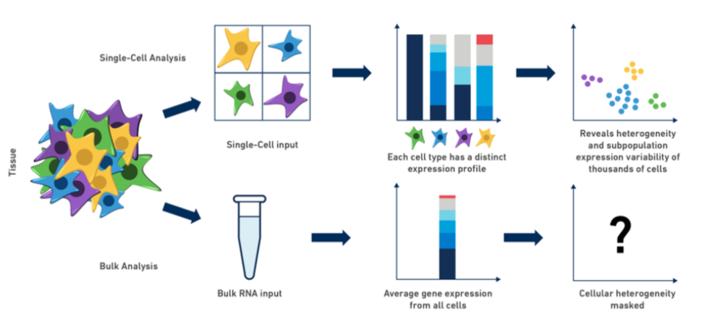
scRNA to study Heterogeneity in cell populations
https://www.10xgenomics.com/blog/single-cell-rna-seq-an-introductory-overview-and-tools-for-getting-started
Notes:
The role of DNA and RNA in a cell, and typical analysis goals

Slide 20
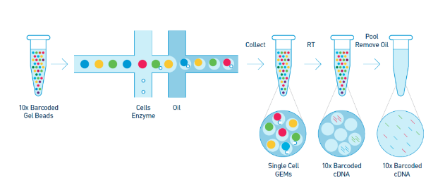
10x single cell technology
Bulk
sequencing
Microfluidics chip
https://github.com/hbctraining/scRNA-seq
Notes:
Barcoded beads, Cells and RT reagent, oil are added to a microfluidics chip
An emulsion of oil droplets is produced “Gell beads in emulsion” (GEM)
Each GEM contains a single cell, a single bead and RT reagent
Within the GEM a cell is lysed, the gel bead is dissolved, and reverse transcription of the mRNA occurs
As a result, all cDNA from a single cell will have the same barcode and can be mapped back to the cell of origin

Slide 21
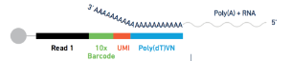
10x single cell technology
Bulk
sequencing
Microfluidics chip
Beads are barcoded, and RT occurs inside the GEM -> all reads from a given will have the same barcode
https://github.com/hbctraining/scRNA-seq
Notes:
Barcoded beads, Cells and RT reagent, oil are added to a microfluidics chip
An emulsion of oil droplets is produced “Gell beads in emulsion” (GEM)
Each GEM contains a single cell, a single bead and RT reagent
Within the GEM a cell is lysed, the gel bead is dissolved, and reverse transcription of the mRNA occurs
As a result, all cDNA from a single cell will have the same barcode and can be mapped back to the cell of origin

Slide 22
Our (bulk) RNAseq Workflow
Process Raw Reads (QC, adapter trimming)
Read Alignment
Gene Quantification
Differential Expression

Slide 23
Workflow
Process Raw Reads (QC, adapter trimming)
Read Alignment
Gene Quantification
Differential Expression

Slide 24
Raw reads in Fastq format
@SRR098401.109756285
GACTCACGTAACTTTAAACTCTAACAGAAATATACTA…
+
CAEFGDG?BCGGGEEDGGHGHGDFHEIEGGDDDD…
Sequence identifier
Sequence
+ (optionally lists the sequence identifier again)
Quality string

Slide 25
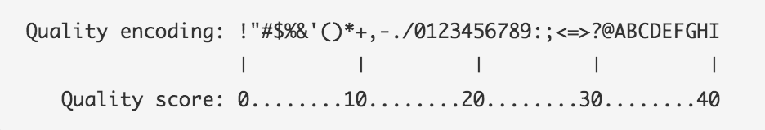
Base Quality Scores
The symbols we see in the read quality string are an encoding of the quality score:
A quality score is a prediction of the probability of an error in base calling:
Quality Score | Probability of Incorrect Base Call | Inferred Base Call Accuracy
10 (Q10) | 1 in 10 | 90%
20 (Q20) | 1 in 100 | 99%
30 (Q30) | 1 in 1000 | 99.9%
https://www.illumina.com/science/education/sequencing-quality-scores.html
Notes:
Q = -log_10(e), e = probability of error

Slide 26
Base Quality Scores
The symbols we see in the read quality string are an encoding of the quality score:
A quality score is a prediction of the probability of an error in base calling:
Quality Score | Probability of Incorrect Base Call | Inferred Base Call Accuracy
10 (Q10) | 1 in 10 | 90%
20 (Q20) | 1 in 100 | 99%
30 (Q30) | 1 in 1000 | 99.9%
Back to our read:
@SRR098401.109756285
GACTCACGTAACTTTAAACTCTAACAGAAATATACTA…
+
CAEFGDG?BCGGGEEDGGHGHGDFHEIEGGDDDD…
C –> Q = 34 -> Probability < 1/1000 of an error
https://www.illumina.com/science/education/sequencing-quality-scores.html

Slide 27
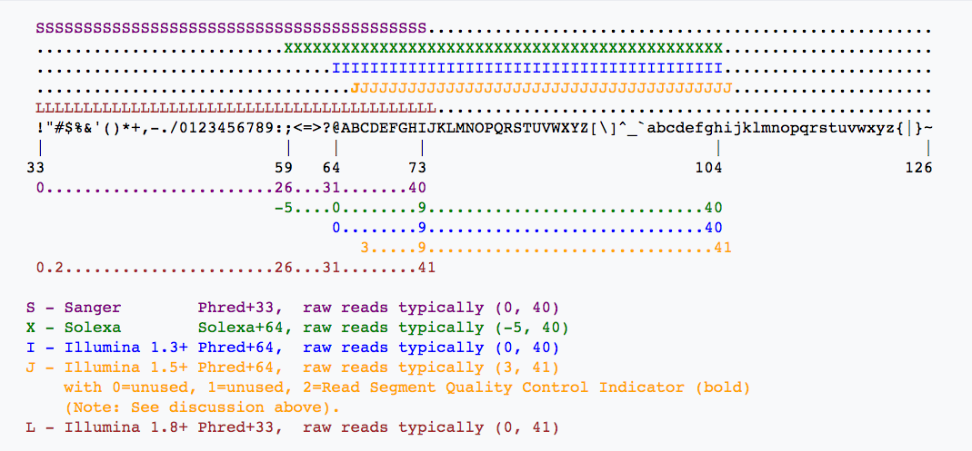
Base Quality Scores
https://en.wikipedia.org/wiki/FASTQ_format

Slide 28
Raw read quality control
Quality distribution over the length of the read
GC content
Per base sequence content
Adapters in Sequence

Slide 29
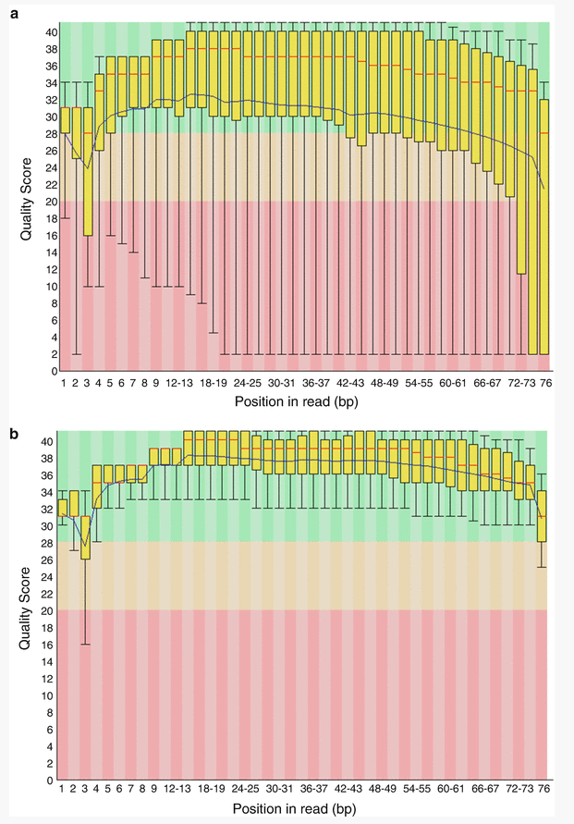
FastQC: Sequence Quality Histogram
Quality Score
Position in read (bp)
Position in read (bp)
GOOD
High quality over the length of the read
BAD
Read quality drops at the beginning and end

Slide 30
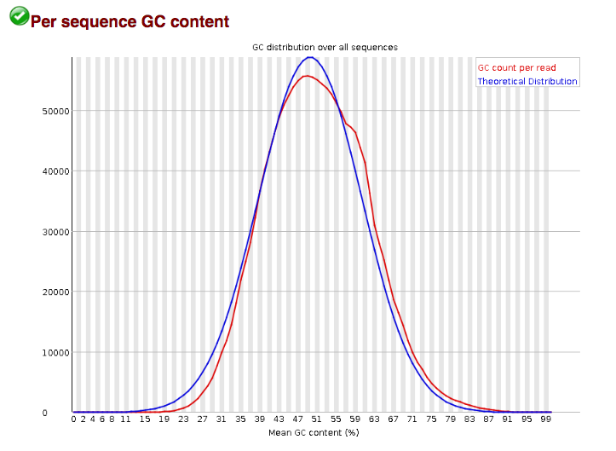
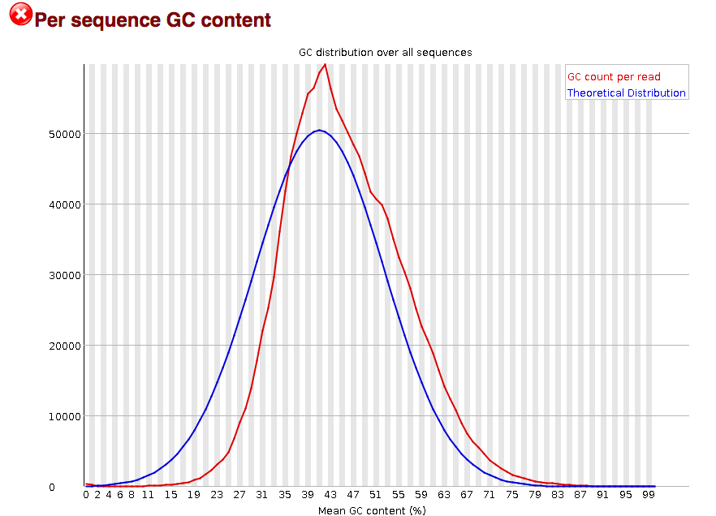
FastQC: Per sequence GC content
Number of Reads
Mean GC content (%)
Mean GC content (%)
Mean GC content (%)
GOOD: follows normal distribution (sum of deviations is < 15% of reads)
BAD: can indicate contamination with adapter dimers, or another species

Slide 31
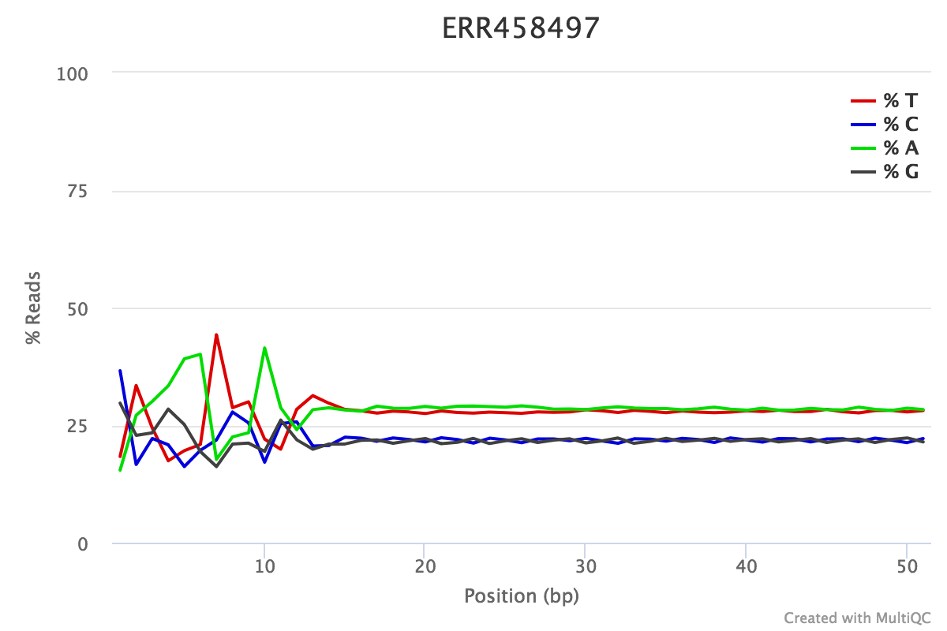
FastQC: Per Base Sequence Content
% Reads
Position (bp)
EXPECTED for RNAseq
Proportion of each position for which each DNA base has been called
RNAseq data tends to show a positional sequence bias in the first ~12 bases
The "random" priming step during library construction is not truly random and certain hexamers are more prevalent than others
Studies have shown that this does NOT cause mis-called bases or drastic bias in sequenced fragments Read quality drops at the beginning and end
sequencing.qcfail.com

Slide 32
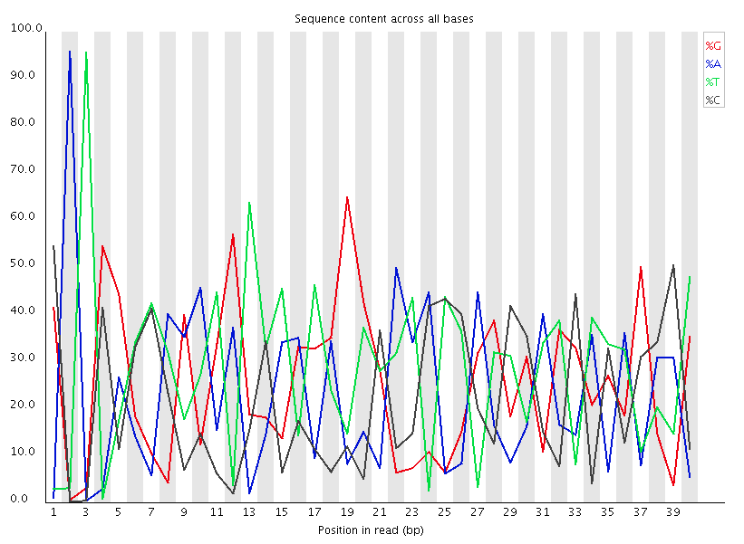
FastQC: Per Base Sequence Content
EXPECTED
BAD:
Shows a strong positional bias throughout the reads, which in this case is due to the library having a certain sequence that is overrepresented

Slide 33
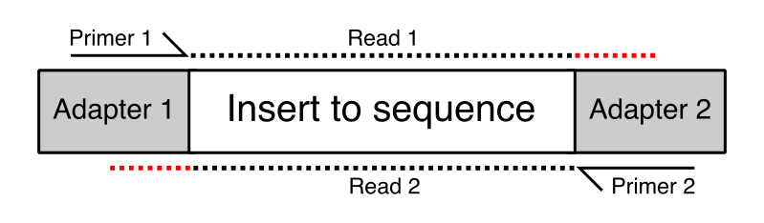
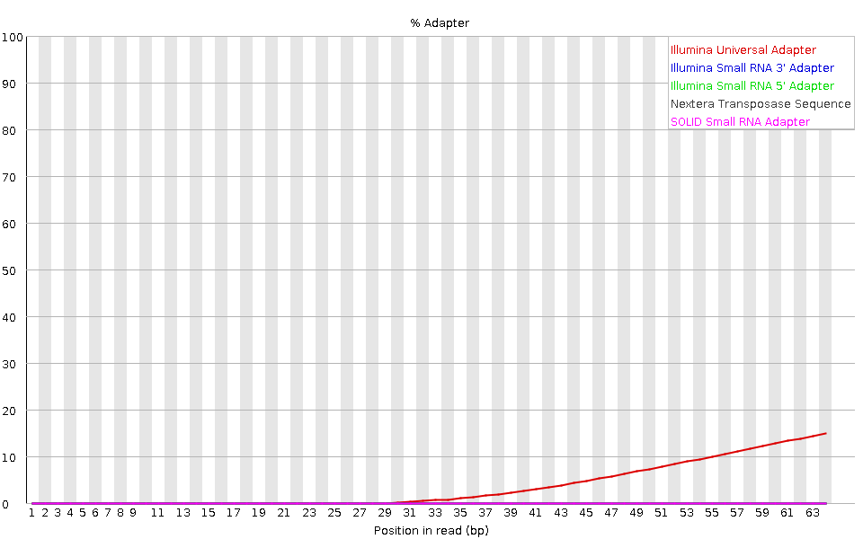
FastQC: Adapter content
The cause: The “insert” sequence is shorter than the read, and the read contains part of the adapter sequence
FastQC will scan each read for the presence of known adapter sequences
The plot shows that the adapter content rises over the course of the read
Solution – Adapter trimming!
Position in read (bp)
sequencing.qcfail.com

Slide 34
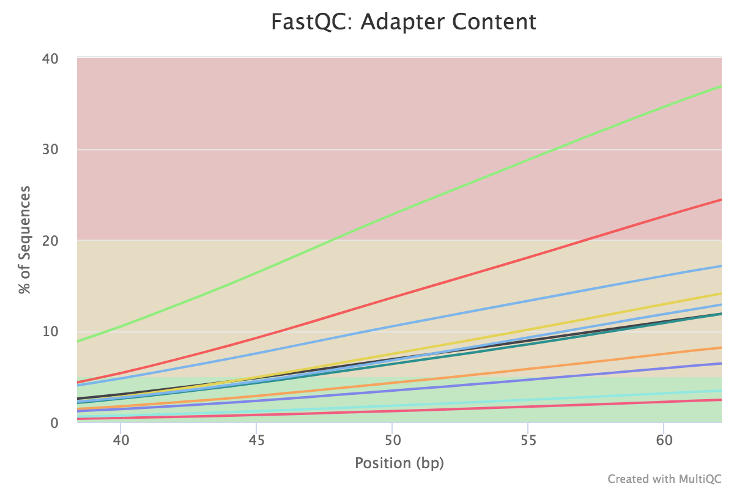
FastQC -> MultiQC
Should view all samples at once to notice abnormalities for our dataset.
% Sequences
Position in read (bp)

Slide 35
Adapter trimming
Trim Galore! is a tool that:
Scans and removes known Illumina or custom adapters
Performs read trimming for low quality regions at the end of reads
Removes reads that become too short in the trimming process

Slide 36
Workflow
Process Raw Reads (QC, adapter trimming)
Read Alignment
Gene Quantification
Differential Expression

Slide 37
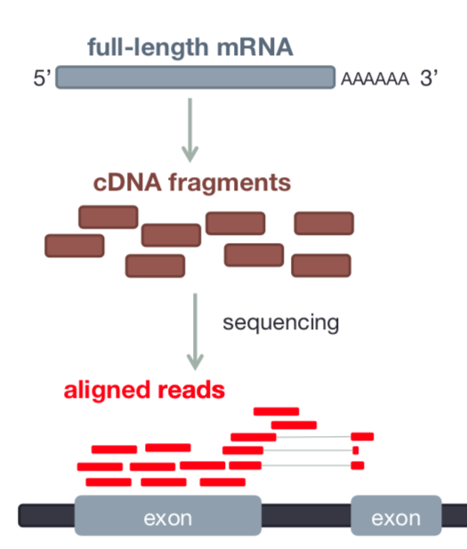
Read Alignment
RNAseq data originates from spliced mRNA (no introns)
When aligning to the genome, our aligner must find a spliced alignment for reads
Reference sequence

Slide 38
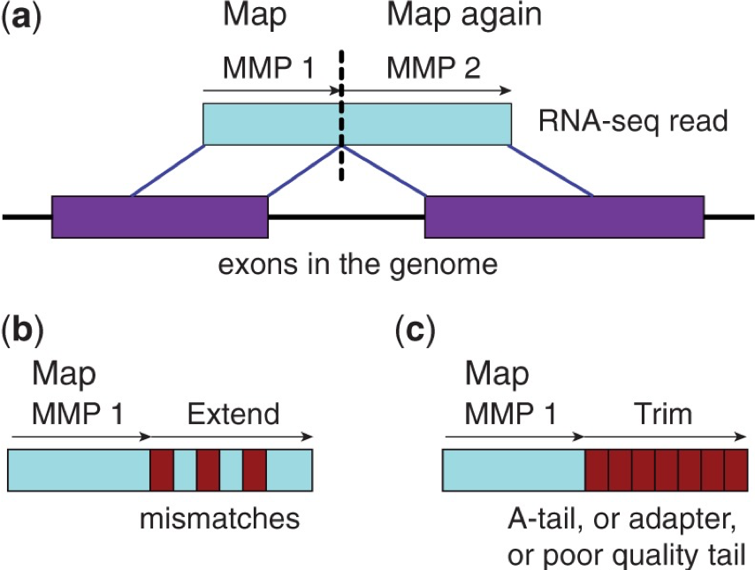
STAR Aligner (Spliced Transcripts Alignment to a Reference)
Highly accurate, memory intensive aligner Two phase mapping process
Find Maximum Mappable Prefixes (MMP) in a read. MMP can be extended by
mismatches
Indels
soft-clipping
Dobin et al Bioinformatics 2013

Slide 39
STAR Aligner (Spliced Transcripts Alignment to a Reference)
Highly accurate, memory intensive aligner Two phase mapping process
Find Maximum Mappable Prefixes (MMP) in a read. MMP can be extended by
mismatches
Indels
soft-clipping
2. Clustering MMP, stitching and scoring to determine final read location
Dobin et al Bioinformatics 2013

Slide 40
STAR Aligner (Spliced Transcripts Alignment to a Reference)
Highly accurate, memory intensive aligner Two phase mapping process
Find Maximum Mappable Prefixes (MMP) in a read. MMP can be extended by
mismatches
Indels
soft-clipping
2. Clustering MMP, stitching and scoring to determine final read location
Output is a Sequence Alignment Map (SAM) file
Dobin et al Bioinformatics 2013

Slide 41
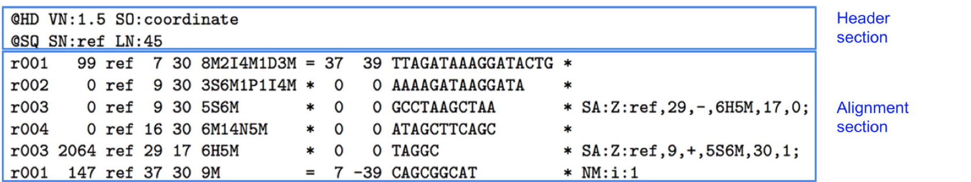
Sequence Alignment Map (SAM)
Reference seq
Reads
TTAGAT
GATAAC
CIGAR: summary of alignment, e.g. match, gap, insertion, deletion
Mapping Quality
Position
Ref Sequence name
Flag: indicates alignment information e.g. paired, aligned, etc
https://broadinstitute.github.io/picard/explain-flags.html
Read ID
www.samformat.info

Slide 42
Sequence Alignment Map (SAM)
Reference seq
Reads
TTAGAT
GATAAC
Paired end info
Optional Fields
Quality Score
Sequence
www.samformat.info

Slide 43
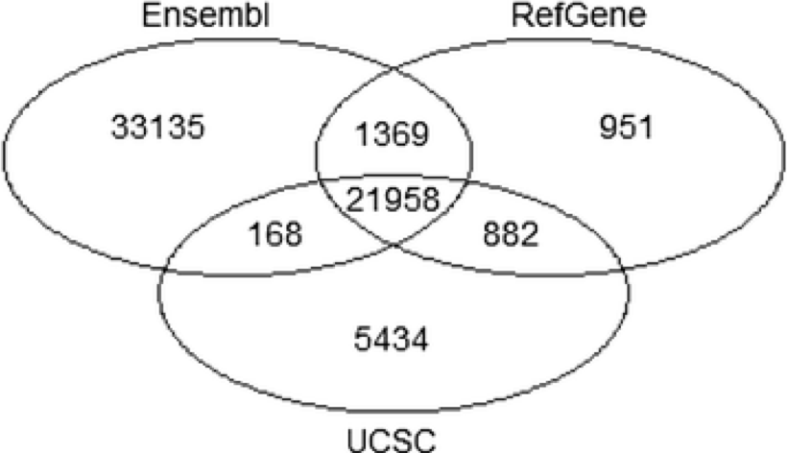
Genome Annotation Standards
STAR can use an annotation file gives the location and structure of genes in order to improve alignment in known splice junctions
Annotation is dynamic and there are at least three major sources of annotation
The intersection among RefGene, UCSC, and Ensembl annotations shows high overlap. RefGene has the fewest unique genes, while more than 50% of genes in Ensembl are unique
Be consistent with your choice of annotation source!
Zhao et al Bioinformatics 2015

Slide 44
Gene Annotation Format (GTF)
In order to count genes, we need to know where they are located in the reference sequence
STAR uses a Gene Transfer Format (GTF) file for gene annotation
Frame
Strand
Chrom
Source
Feature type
Start
Stop
(Score)
Attribute
chr5 | hg38_refGene | exon | 138465492 | 138466068 | . | + | . | gene_id "EGR1";
chr5 | hg38_refGene | CDS | 138465762 | 138466068 | . | + | 0 | gene_id "EGR1";
chr5 | hg38_refGene | start_codon | 138465762 | 138465764 | . | + | . | gene_id "EGR1";
chr5 | hg38_refGene | CDS | 138466757 | 138468078 | . | + | 2 | gene_id "EGR1";
chr5 | hg38_refGene | exon | 138466757 | 138469315 | . | + | . | gene_id "EGR1";
chr5 | hg38_refGene | stop_codon | 138468079 | 138468081 | . | + | . | gene_id "EGR1";
https://useast.ensembl.org/info/website/upload/gff.html

Slide 45
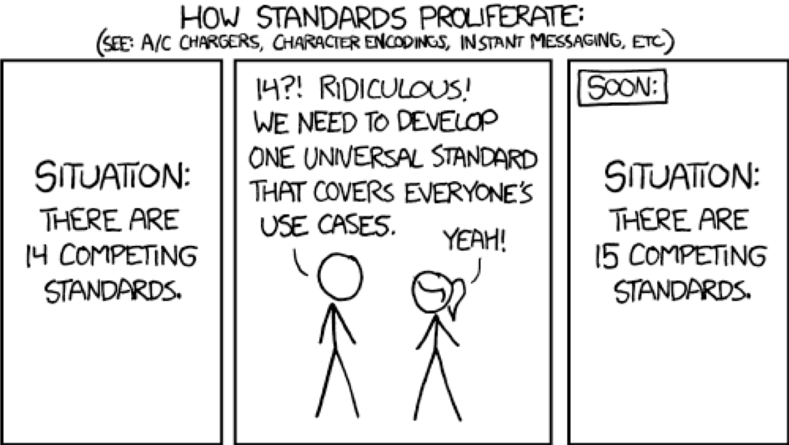
A note on standards
https://xkcd.com/927/

Slide 46
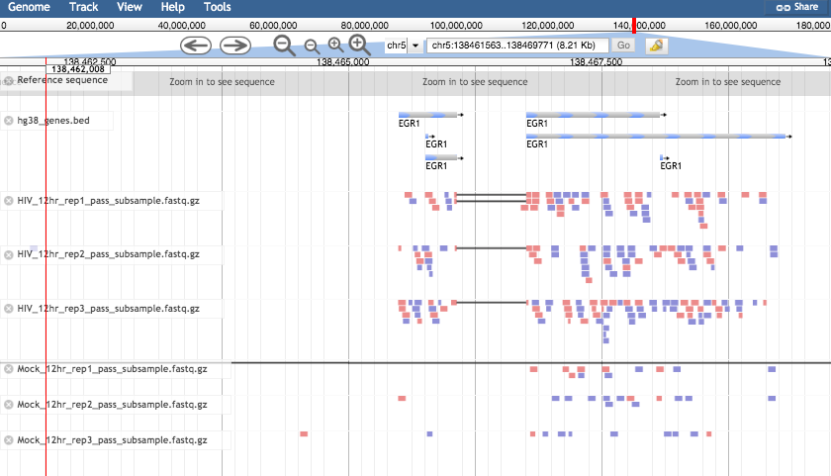
Visualizing reads with JBrowse

Slide 47
Workflow
Process Raw Reads (QC, adapter trimming)
Read Alignment
Gene Quantification
Differential Expression

Slide 48
Counting reads for each gene
Gene 1
Gene 2
Reference seq
Read

Slide 49
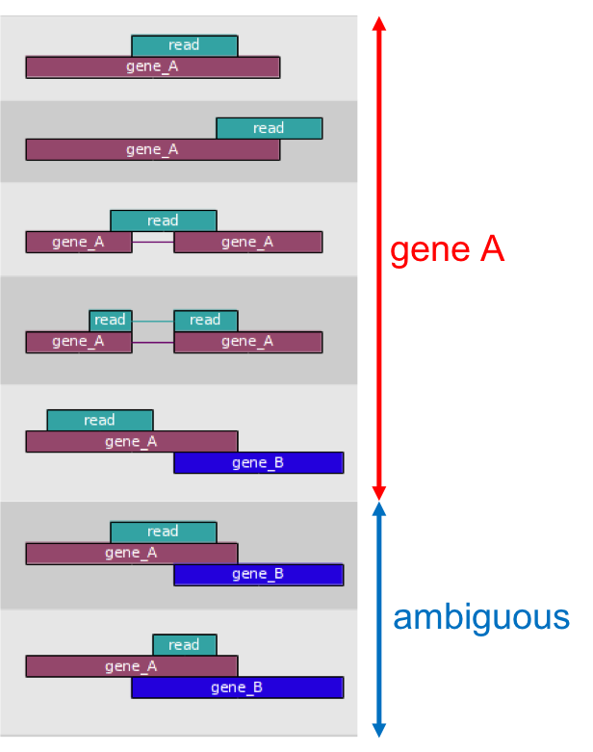
Counting reads: featurecounts
The mapped coordinates of each read are compared with the features in the GTF file
Reads that overlap with a gene by >=1 bp are counted as belonging to that feature
Ambiguous reads will be discarded
Output will be a matrix of genes and samples

Slide 50
Counting reads: featurecounts
The mapped coordinates of each read are compared with the features in the GTF file
Reads that overlap with a gene by >=1 bp are counted as belonging to that feature
Ambiguous reads will be discarded
Output will be a matrix of genes and samples
Result is a gene count matrix:
Gene | Sample 1 | Sample 2 | Sample 3 | Sample 4
A | 1000 | 1000 | 100 | 10
B | 10 | 1 | 5 | 6
C | 10 | 1 | 10 | 20

Slide 51
Tracking read numbers
Revisit quality control after each processing step!
Number of Reads | Source | Result
Raw reads | FastQC run 1 | 8 M
After Trimming | FastQC run 2 | 7.1 M
Aligned to genome | STAR log | 6 M
Associated with genes | FeatureCounts log | 5.4 M

Slide 52
Workflow
Process Raw Reads (QC, adapter trimming)
Read Alignment
Gene Quantification
Differential Expression

Slide 53
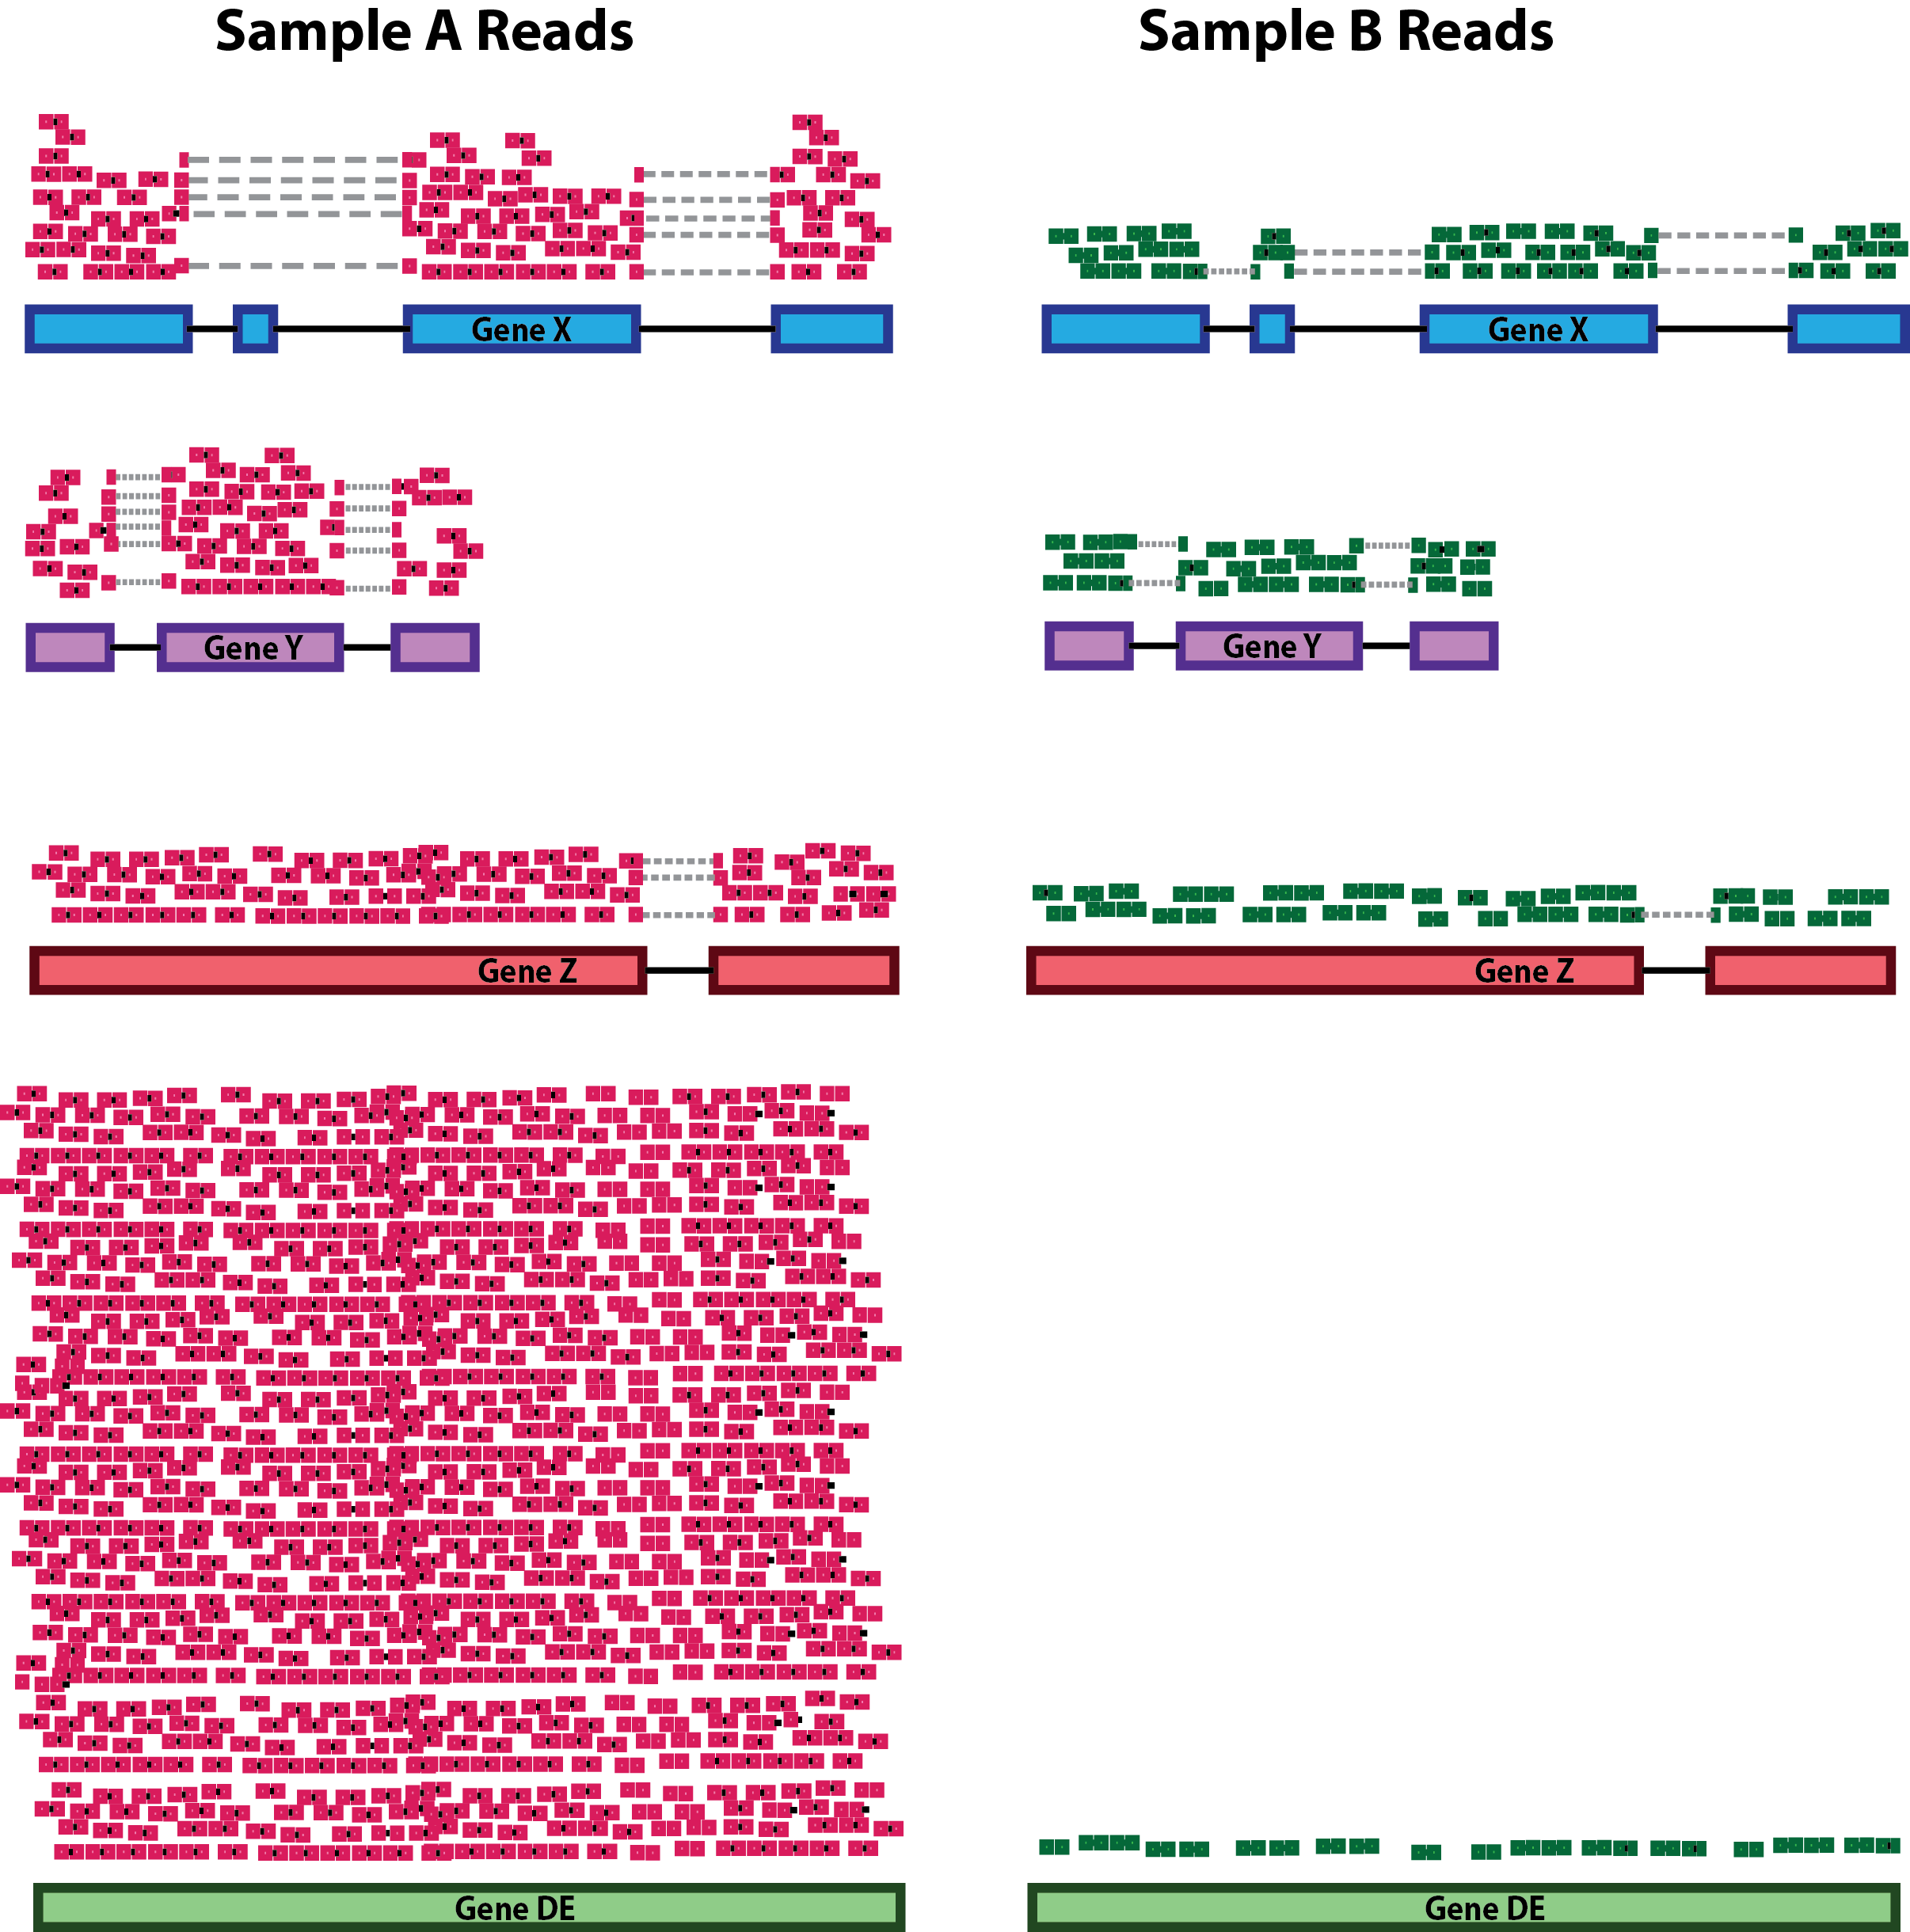
Testing for Differential Expression
The goal of differential expression analysis (DE) is to find gene differences between conditions, developmental stages, treatments etc.
In particular DE has two goals:
Estimate the magnitude of expression differences;
Estimate the significance of expression differences.

Slide 54
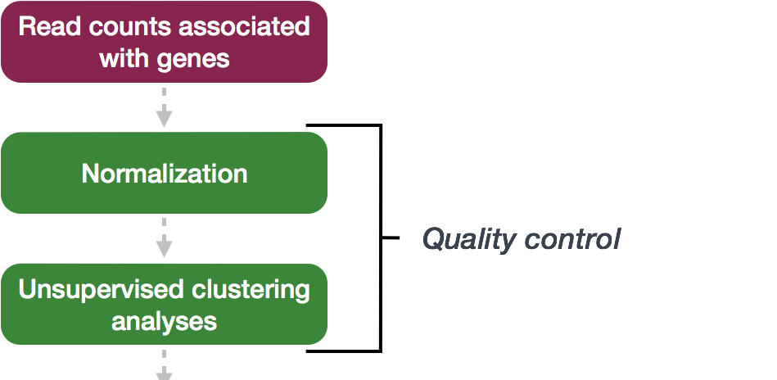
Differential Expression with DESeq2
All steps are done with one click in Galaxy!
Differential Expression Analysis
https://hbctraining.github.io/DGE_workshop

Slide 55
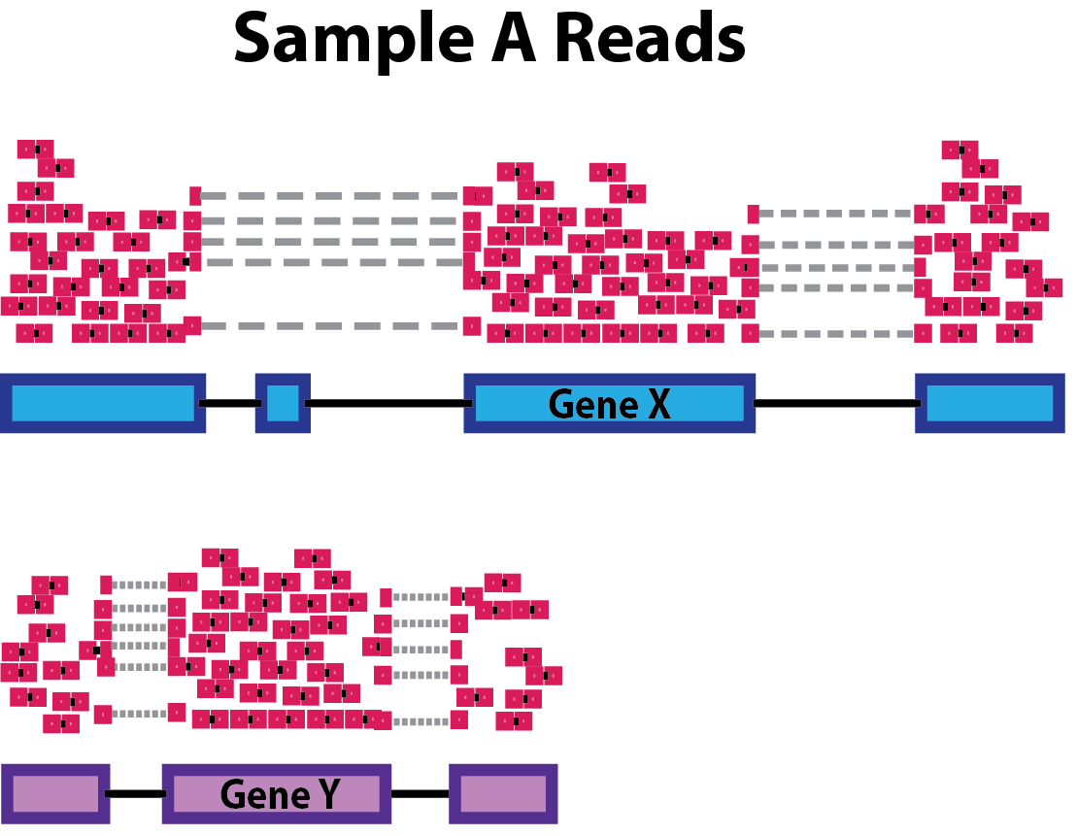
Normalization
The number of sequenced reads mapped to a gene depends on
Gene Length

Slide 56
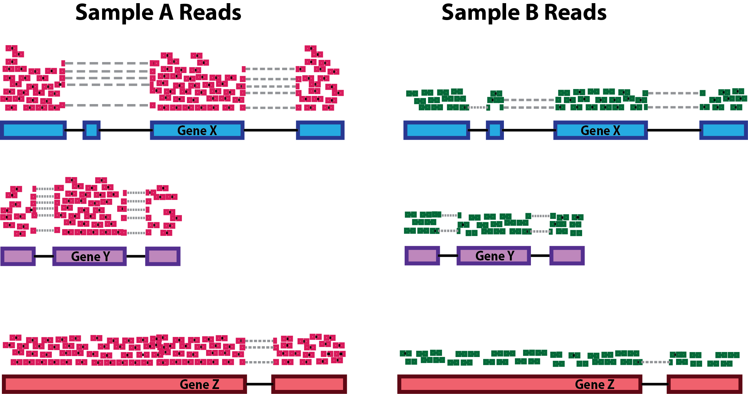
Normalization
The number of sequenced reads mapped to a gene depends on
Gene Length
Sequencing depth

Slide 57
Normalization
The number of sequenced reads mapped to a gene depends on
Gene Length
Sequencing depth
The expression level of other genes in the sample
Notes:
In the example, if we were to divide each sample by the total number of counts to normalize, the counts would be greatly skewed by the DE gene, which takes up most of the counts for Sample A, but not Sample B. Most other genes for Sample A would be divided by the larger number of total counts and appear to be less expressed than those same genes in Sample B.

Slide 58
Normalization
The number of sequenced reads mapped to a gene depends on
Gene Length
Sequencing depth
The expression level of other genes in the sample
It's own expression level
Normalization eliminates the factors that are not of interest!

Slide 59
Normalization methods
Normalization method | Description | Accounted factors | For Differential Expression?
CPM (counts per million) | counts scaled by total number of reads in a sample | sequencing depth | NO
TPM (transcripts per kilobase million) | counts per length of transcript (kb) per million reads mapped | sequencing depth and gene length | NO
RPKM/FPKM (reads/fragments per kilobase of exon per million reads/fragments mapped) | similar to TPM | sequencing depth and gene length | NO
DESeq2’s median of ratios [1] | counts divided by sample-specific size factors determined by median ratio of gene counts relative to geometric mean per gene | sequencing depth and RNA composition | YES
https://hbctraining.github.io/DGE_workshop

Slide 60
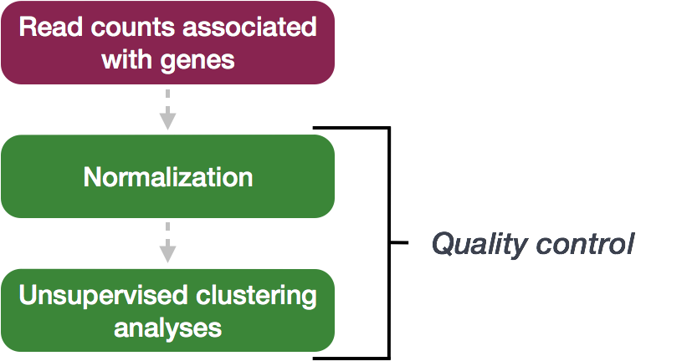
Unsupervised Clustering

Slide 61

Principle Component Analysis
Each gene that we measure is a "dimension" and we can visualize up to 3
PCA can help us visualize relationships in out data in a lower number of dimensions
PCA is an important QC step! Do your samples cluster as expected?
Here is an example with three genes measured in many samples:
Gene | Sample 1 | Sample 2 | Sample 3 | Sample 4
Gene 1 | 1000 | 1000 | 100 | 10
Gene 2 | 10 | 1 | 5 | 6
Gene 3 | 10 | 1 | 10 | 20
…

Slide 62
Differential Expression with DESeq2
Differential Expression Analysis
https://hbctraining.github.io/DGE_workshop

Slide 63
Multi-factor experiment design
Factor 1:
Infection status (Mock or HIV)
Factor 2:
Time (12 or 24 hr)
Mock
HIV
12 hour
24 hour
Sample | Condition | Time
1 | Mock | 12
2 | Mock | 12
3 | Mock | 12
4 | Mock | 24
5 | Mock | 24
6 | Mock | 24
7 | HIV | 12
8 | HIV | 12
9 | HIV | 12
10 | HIV | 24
11 | HIV | 24
12 | HIV | 24

Slide 64
Multi-factor experiment design
Mock
HIV
Differential Expression compares two conditions
We’ll choose a primary factor = Infection status for comparison
More complex statistics can include multiple factors
12 hour
24 hour
Sample | Condition | Time
1 | Mock | 12
2 | Mock | 12
3 | Mock | 12
4 | Mock | 24
5 | Mock | 24
6 | Mock | 24
7 | HIV | 12
8 | HIV | 12
9 | HIV | 12
10 | HIV | 24
11 | HIV | 24
12 | HIV | 24

Slide 65
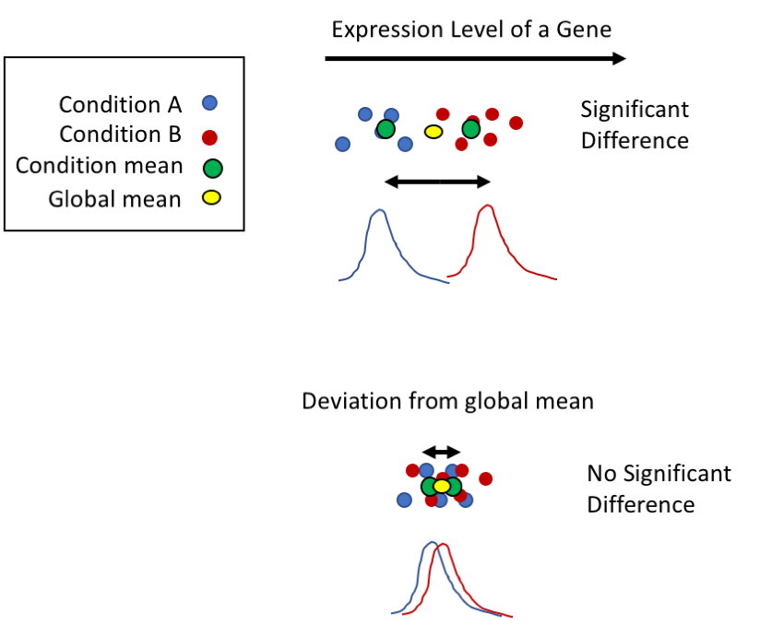
DESeq2 Test for Differential Expression
Notes:
Fit a probability distribution to each gene we measured
Perform a statistical test (Wald test) to determine whether there is a difference between conditions
Replicates are necessary

Slide 66
DESeq2 Results table
GeneID | Base mean | log2(FC) | StdErr | Wald-Stats | P-value | P-adj
EGR1 | 1273.65 | -2.22 | 0.12 | -18.65 | 1.25E-77 | 1.44E-73
MYC | 5226.12 | 1.41 | 0.11 | 12.53 | 4.95E-36 | 2.87E-32
OPRK1 | 78.35 | -1.83 | 0.17 | -10.57 | 4.11E-26 | 1.59E-22
CCNI2 | 7427.12 | 0.93 | 0.10 | 9.43 | 4.27E-21 | 1.24E-17
STRA6 | 785.78 | 0.97 | 0.11 | 8.61 | 7.29E-18 | 1.69E-14
Mean of normalized counts – averaged over all samples from two conditions
Log of the fold change between two conditions
Standard Error of Log FC estimate – will reflect the ”noisiness” of the gene
P-value – the probability that the log2FoldChange is not zero
Adjusted P value – accounting for multiple testing correction

Slide 67
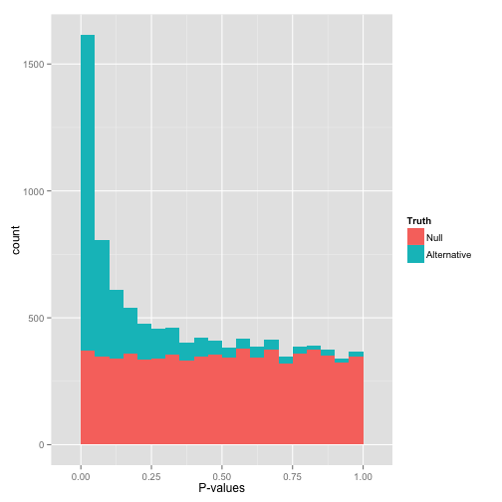
DESeq2 P-value histogram
Plot of raw p-values
P-value: Probability of getting a logFC as extreme as observed if the true logFC = 0 for that gene (null hypothesis)
How to interpret:
Random P-values are expected to be uniform, if you have true positives you should see a peak close to zero
http://varianceexplained.org/statistics/interpreting-pvalue-histogram/
Notes:
That flat distribution along the bottom is all your null p-values, which are uniformly distributed between 0 and 1. Why are null p-values uniformly distributed? Because that’s part of a definition of a p-value: under the null, it has a 5% chance of being less than .05, a 10% chance of being less than .1, etc. This describes a uniform distribution.

Slide 68
DESeq2 MA plot
Shows the relationship between
M: The difference in expression
Log(HIV) – Log(Mock) = Log(HIV/Mock)
A: Average expression strength Average(Mock, HIV)
Genes with adjusted p-value < 0.1 are in red
Can be used as an overview or to diagnose problems
DE Genes

Slide 69
Conclusions
Process Raw Reads (QC, adapter trimming)
Read Alignment
Gene Quantification
Differential Expression

Slide 70
References
https://www.bioconductor.org/packages/3.3/bioc/vignettes/DESeq2/inst/doc/DESeq2.pdf
https://hbctraining.github.io/DGE_workshop
https://galaxyproject.org/tutorials/rb_rnaseq/

Slide 71

Web-based platform for running data analysis and integration, geared towards bioinformatics
Open-source
Developed at Penn State, Johns Hopkins, OHSU and Cleveland Clinic with many more outside contributions
Large and extremely responsive community

Slide 72
Benefits of Galaxy
Accessible for inexperienced programmers
Workflow system
Lots of tools available
Reproducibility of results through history
Easy to create new tools
Transparency

Slide 73

Production Environment
HPC Cluster
node | node | node | node
node | node | node | node
Proxy web-server
(Apache)
Job scheduler
(SLURM)
PAM Authentication
PostgreSQL Database server
Galaxy web-server
Notes:
Add user laptop
Galaxy handles authentication
PAM was already set up on the cluster for all cluster accounts, so we just take advantage of it. We did use Apache and PAM at first, but switched because we couldn’t get the logout to work.
Galaxy and apache on cluster server but not compute node
POSTGRESQL not a seperate server, on the same server as galaxy but hopefully one day

Slide 74
Access Galaxy
https://galaxy.cluster.tufts.edu/
Login with you cluster username and password!

Slide 75
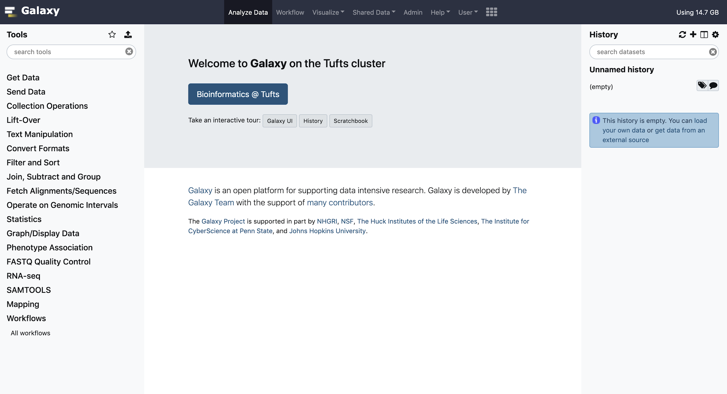
Galaxy Interface

Slide 76
TOOLS

Slide 77
TOOLS
HISTORY

Slide 78
TOOLS
MAIN
HISTORY

Slide 79
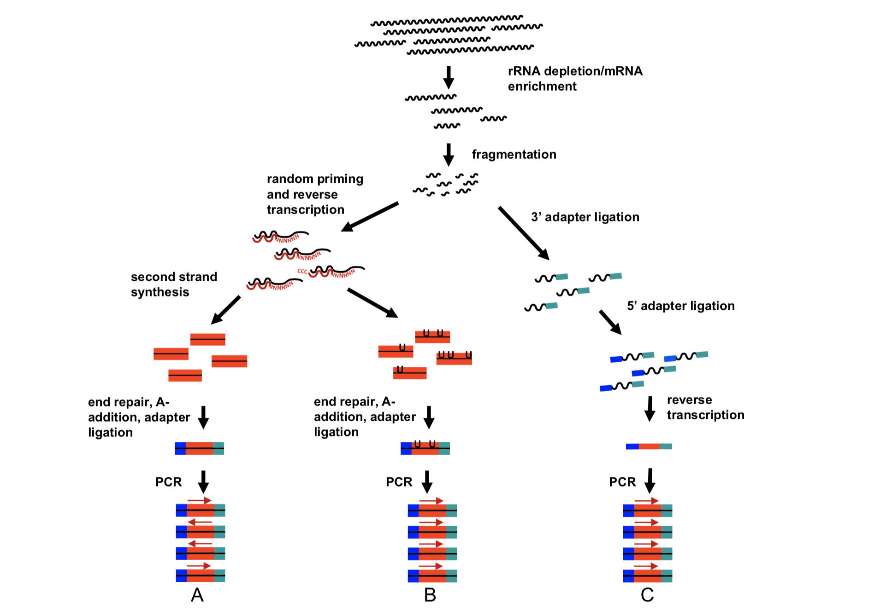
RNA extraction
mRNA enrichment
Fragmentation ~200 bp
Random priming + reverse transcription
Double stranded cDNA synthesis
Sequencing adapter ligation
PCR
Good resource: Griffiths et al Plos Comp Bio 2015

Slide 80
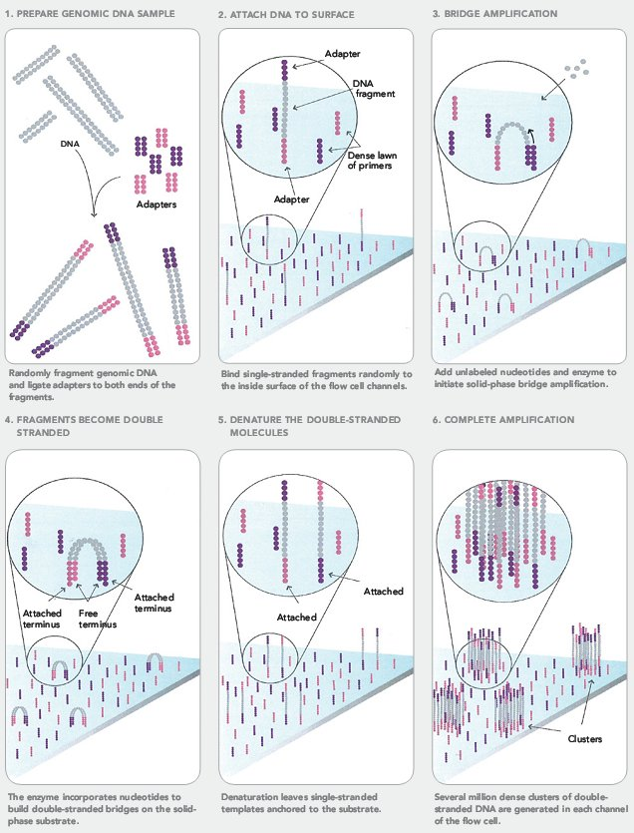
Next Generation Sequencing (NGS)
https://sites.google.com/site/himbcorelab/illumina_sequencing

Slide 81
Next Generation Sequencing (NGS)
https://sites.google.com/site/himbcorelab/illumina_sequencing

Slide 82
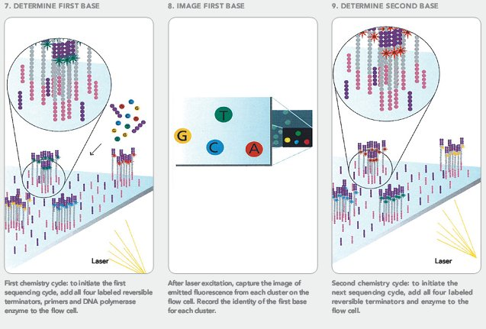
Next Generation Sequencing (NGS)
https://sites.google.com/site/himbcorelab/illumina_sequencing

Slide 83
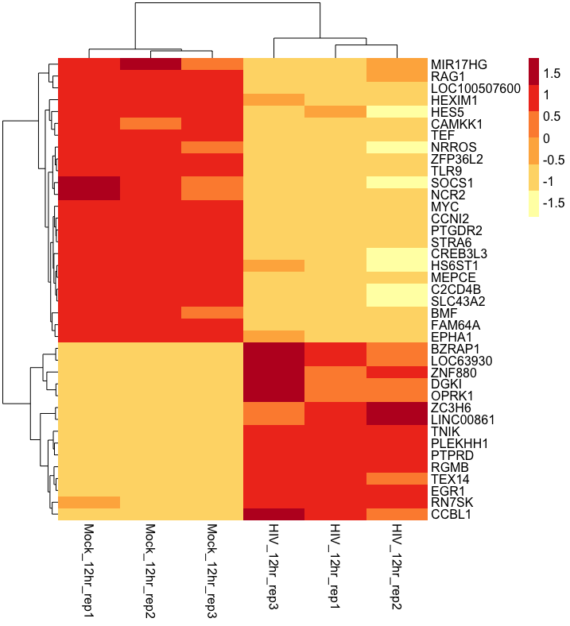
Final Heatmap – not part of DESeq2 output

Slide 84
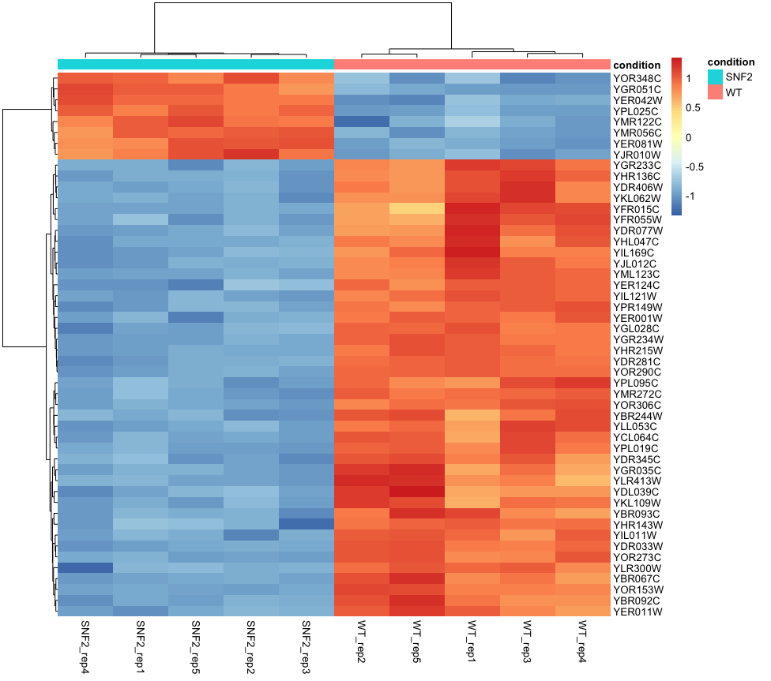
Common RNAseq analysis goals
- Novel transcript discovery
- Transcriptome assembly
- Single cell analysis
- Quantify alternative splicing
- Differential Expression
Replace with actual heatmap

Slide 85
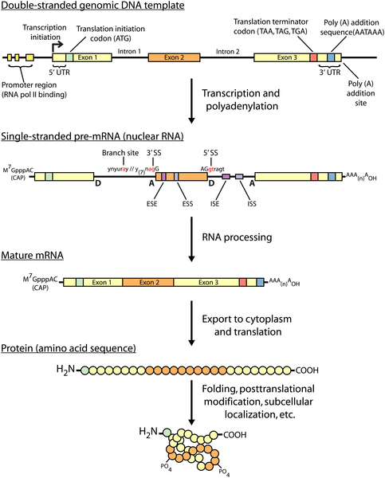

Fig 1. An overview of the central dogma of molecular biology.
Griffith M, Walker JR, Spies NC, Ainscough BJ, Griffith OL (2015) Informatics for RNA Sequencing: A Web Resource for Analysis on the Cloud. PLOS Computational Biology 11(8): e1004393. https://doi.org/10.1371/journal.pcbi.1004393
https://journals.plos.org/ploscompbiol/article?id=10.1371/journal.pcbi.1004393

Slide 86
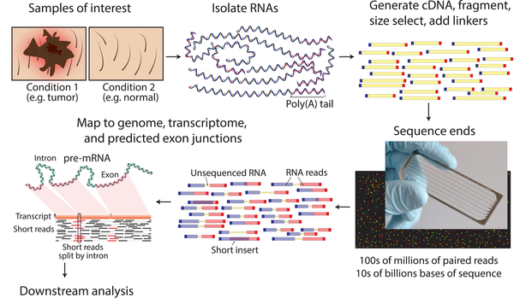
Fig 2. RNA-seq data generation.
Griffith M, Walker JR, Spies NC, Ainscough BJ, Griffith OL (2015) Informatics for RNA Sequencing: A Web Resource for Analysis on the Cloud. PLOS Computational Biology 11(8): e1004393. https://doi.org/10.1371/journal.pcbi.1004393
https://journals.plos.org/ploscompbiol/article?id=10.1371/journal.pcbi.1004393

Slide 87
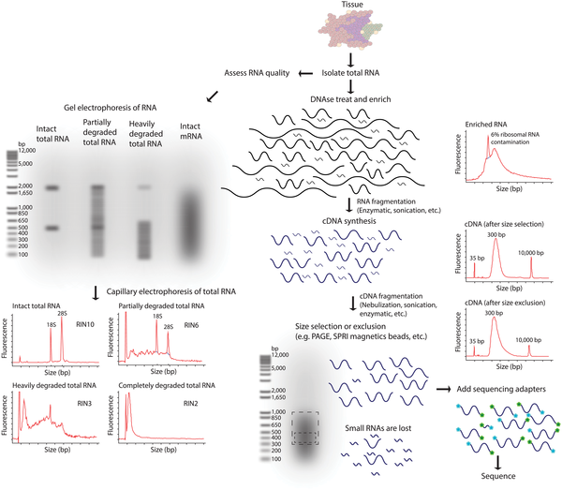
Fig 3. RNA-seq library fragmentation and size selection strategies that influence interpretation and analysis.
Griffith M, Walker JR, Spies NC, Ainscough BJ, Griffith OL (2015) Informatics for RNA Sequencing: A Web Resource for Analysis on the Cloud. PLOS Computational Biology 11(8): e1004393. https://doi.org/10.1371/journal.pcbi.1004393
https://journals.plos.org/ploscompbiol/article?id=10.1371/journal.pcbi.1004393

Slide 88
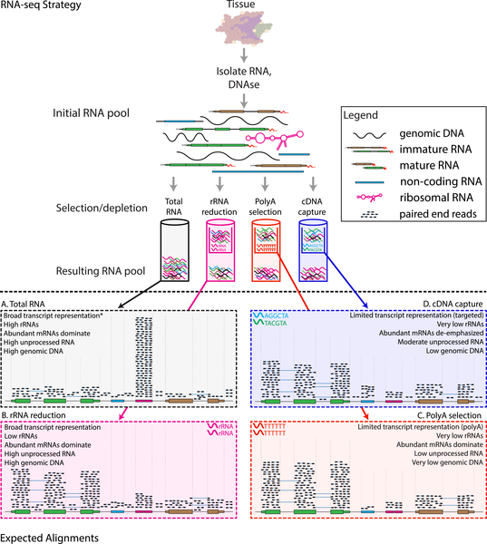
Fig 4. RNA-seq library enrichment strategies that influence interpretation and analysis.
Griffith M, Walker JR, Spies NC, Ainscough BJ, Griffith OL (2015) Informatics for RNA Sequencing: A Web Resource for Analysis on the Cloud. PLOS Computational Biology 11(8): e1004393. https://doi.org/10.1371/journal.pcbi.1004393
https://journals.plos.org/ploscompbiol/article?id=10.1371/journal.pcbi.1004393

Slide 89

Fig 6. Comparison of stranded and unstranded RNA-seq library methods and their influence on interpretation and analysis.
Griffith M, Walker JR, Spies NC, Ainscough BJ, Griffith OL (2015) Informatics for RNA Sequencing: A Web Resource for Analysis on the Cloud. PLOS Computational Biology 11(8): e1004393. https://doi.org/10.1371/journal.pcbi.1004393
https://journals.plos.org/ploscompbiol/article?id=10.1371/journal.pcbi.1004393

Slide 90
Test for Differential Expression
DESeq2 will seek to fit a probability distribution to each gene we measured and perform a statistical test to determine whether there is a difference between conditions

Slide 91
Tufts Galaxy Server for Bioinformatics

Slide 92

Normalization: DESeq2 Median of Ratios

Slide 93

Normalization: DESeq2 Median of Ratios

Slide 94

Normalization: DESeq2 Median of Ratios
…
…
Median = 2.08
Median = 0.66

Slide 95

Normalization: DESeq2 Median of Ratios
Visualization of normalization factor for a sample:
Median should be ~1 for each sample, otherwise data should be examined for the presence of large outliers
This method is robust to imbalance in up-/down- regulation and large numbers of differentially expressed genes
Assumptions of this method:
Not all genes are differentially expressed

Slide 96

Normalization: DESeq2 Median of Ratios

Slide 97
Reference-based vs Reference-free RNAseq
RNAseq can be roughly divided into two "types":
Reference genome-based - an assembled genome exists for a species for which an RNAseq experiment is performed. It allows reads to be aligned against the reference genome and significantly improves our ability to reconstruct transcripts. This category would obviously include humans and most model organisms
Reference genome-free - no genome assembly for the species of interest is available. In this case one would need to assemble the reads into transcripts using de novo approaches. This type of RNAseq is as much of an art as well as science because assembly is heavily parameter-dependent and difficult to do well.
In this lesson we will focus on the Reference genome-based type of RNA seq.
https://galaxyproject.org/tutorials/rb_rnaseq/

